Slide 1
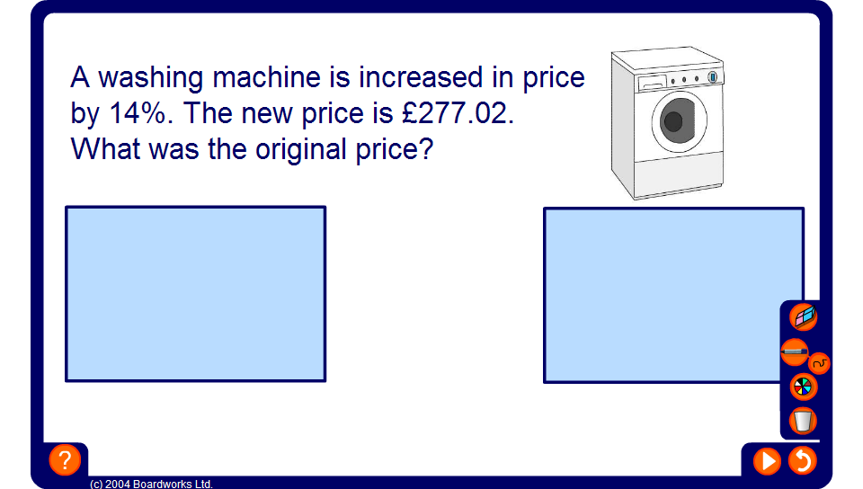


Finding a percentage increase or decrease
Sometimes, we are given an original value and a new value and we are asked to find the percentage increase or decrease.
We can do this using the following formulae:
actual increase
Percentage increase =
× 100%
original amount
actual decrease
Percentage decrease =
× 100%
original amount
Notes:
Explain that to calculate a percentage increase or decrease we start by working out the actual increase or decrease by finding the difference between the new amount and the old amount. This is then written as a fraction of the original amount and converted to a percentage by multiplying it by 100%.
Compare this method to writing one number as a percentage of another (see slides 15 and 16 for examples).

